Slide 1

DROWSINESS DETECTION FOR CAR DRIVERS

Slide 2
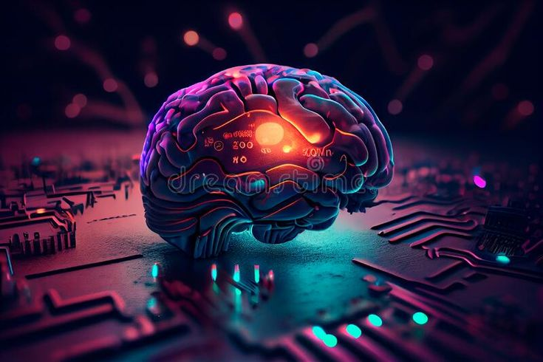
ABSTRACT
This project introduces an advanced Drowsiness detection for car drivers system by using Arduino and infrared sensor technology. Statistics highlightthe substantial impact that fatigued driving plays in anumber of traffic incidents that result in serious injuries andfatalities.
Fatigued driving is a major cause of road accidents.To avoid potential accidents caused by drivers falling asleep,a great deal of testing has been conducted to develop systemsthat can assess driver tiredness and send out alertsbeforehand.

Slide 3

INTRODUCTION
The project “DROWSINESS DETECTION FOR CARDRIVERS” presents a solution for the drowsiness for cardriver problems faced in urban citiesespeciallymetropolitan cities. We address this urgent problem andlessen the risks related to driver weariness by utilizingcutting-edge technologies.
cutting-edge technologies. Our mission is to revolutionizedriver fatigue detection and treatment by utilizing state-of-the-art hardware and creative approaches.The project usesmodern technologies to address the crucial problem ofdriver drowsiness with the goal of transforming roadsafety.

Slide 4
LITERATURE SURVEY
This paper [1] proposes usage of RFID in car detectionsystem to upgrade the user experience and elevate thecontrol the accidents in the cars in an efficient way. Theprincipal objectives of the study were to identify the mostimportant methods, tools, and difficulties in detecting andtreating driver fatigue
Fatigued driving is a major cause of road accidents.To avoid potential accidents caused by drivers falling asleep,a great deal of testing has been conducted to develop systemsthat can assess driver tiredness and send out alertsbeforehand.

Slide 5
PROBLEM STATEMENT
The Drowsy driving is a major cause of road accidents globally, necessitating an effective solution to monitor and alert drivers in real-time. This project aims to develop a drowsiness detection system using IoT technologies, combining sensors like cameras, wearables, and vehicle-based sensors to gather data on the driver's condition and behavior.
The system will employ machine learning algorithms to analyze this data and detect signs of drowsiness accurately. Integrated with IoT platforms, the system will ensure secure data transmission and real-time processing, providing immediate visual, auditory, and haptic alerts to the driver, and potentially notifying emergency contacts if necessary.

Slide 6

PROJECT DESCRIPTION
Drowsy driving remains a significant global concern, posing a grave threat to road safety with its association to numerous accidents. Detecting and treating driver fatigue properly is still difficult, despite extensive awareness campaigns.
Current solutions frequently fall short because they are difficult to use, unreliable, or ineffectual. The lack of complete systems designed with drivers of automobiles in mind exacerbates the problem. Therefore, it's critical to develop a cutting-edge and effective drowsiness detection system specifically for drivers.

Slide 7
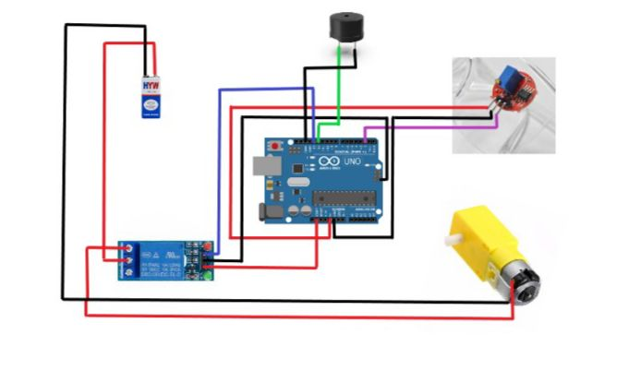
SYSTEM ARCHITECTURE

Slide 8
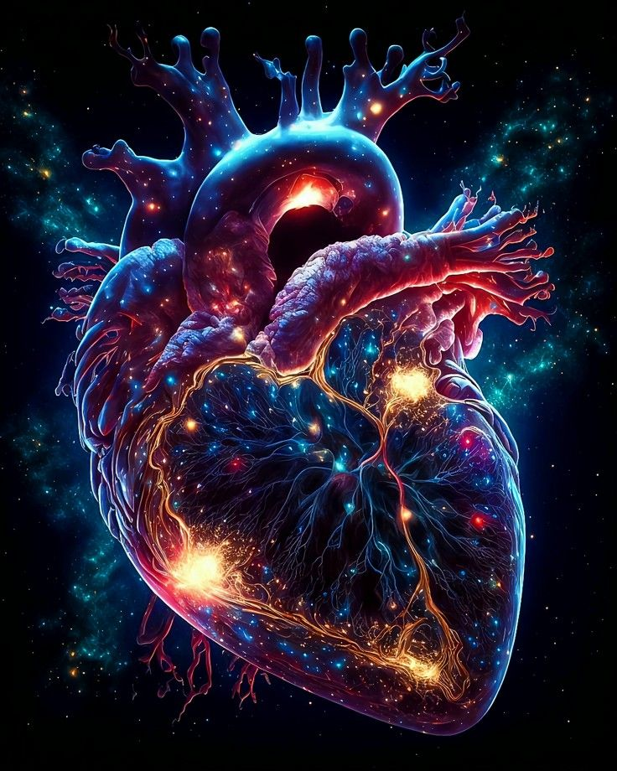
METHODOLOGY
The methodology for developing the drowsiness detection system using IoT involves several key steps: initially, extensive research will be conducted to identify the most effective sensors and algorithms for detecting driver drowsiness.
Following this, the system architecture will be designed, and appropriate hardware components will be selected. In the prototype development phase, sensors will be integrated with an IoT platform to collect and process data, and initial algorithms for drowsiness detection will be implemented.

Slide 9
CONCLUSION
In conclusion, the implementation of a real-time drowsiness detection system and methodology for drivers is the primary goal of this project. In the past, methods for identifying driver weariness have included psychological and vehicle-based evaluations
which may be quite invasive and frequently depend on the physical features of the surrounding area. Unlike these traditional approaches, our suggested solution uses a non-intrusive method to assess the driver's fatigue state.

Slide 10

FUTURE ENHANCEMENT
For future enhancements, We want to improve our system in the future by making it smaller and making sure it can be used in other physical settings, like Middlesex University, which is the only place that is legally permitted to utilize it.
We are committed to improving our system in spite of the restrictions imposed by the source of our research.dditionally, implementing personalized health recommendations based on individual risk assessments could further empower users

Slide 11

REFERENCE
Carpinteiro, C., Lopes, J., Abelha, A., & Santos, M. F. (2023, January 1). A Comparative Study of Classification Algorithms for Early Detection of Drowsiness . Procedia Computer Science. https://doi.org/10.1016/j.procs.2023.03.117
Guan, Z., Li, H., Liu, R., Cai, C., Liu, Y., Li, J., Wang, X., Huang, S., Wu, L., Liŭ, D., Yu, S., Wang, Z., Jia, S., Hou, X., Yang, X., Jia, W., & Sheng, B. (2023, October 1). Artificial intelligence in safety management: Advancements, opportunities, and challenges. Cell Reports Medicine. https://doi.org/10.1016/j.xcrm.2023.101213
Gowthami, S., Reddy, V. S., & Ahmed, M. R. (2024, February 1). Exploring the effectiveness of machine learning algorithms for early detection of Drowsiness Measurement. Sensors. https://doi.org/10.1016/j.measen.2023.100983

